Slide 1
Release the Kraken:
New KRACKs in the 802.11 Standard ACM SIGSAC Conference on Computer and Communications Security Toronto, Canada, 16 October 2018

Slide 2
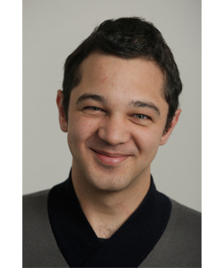

Authors
Mathy Vanhoef
Frank Piessens

Slide 3
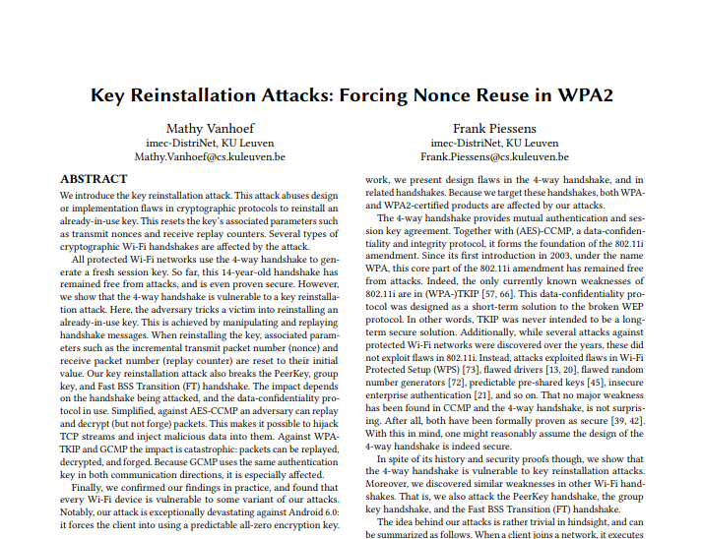
Former One by the Authors

Slide 4
Outcomes of the titled paper
Generalize attacks against the 4-way handshake
Systematic investigation of 802.11 standards for key reinstallations vulnerabilities
Invention of more trickier approaches to trigger reinstallations attack
Investigation of effectiveness of official countermeasure of 802.11 and some patches
Seemingly innocent implementation bugs or protocol features can act as gadgets that enable exploitation of other vulnerabilities.

Slide 5
Some jargons to fathom
802.11
Handshake
Temporal keys in WPA2
PTK
GTK
IGTK
KRACK (Key Reinstallation AttaCKs)

Slide 6
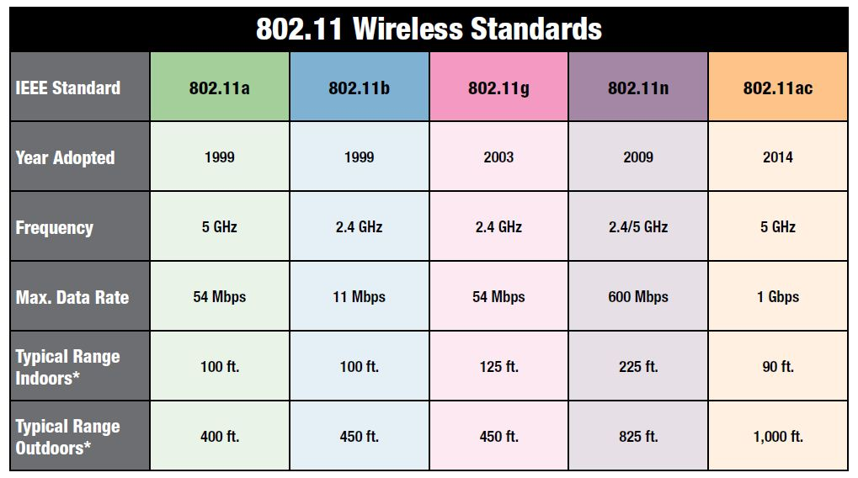

802.11
A set of technology standards for wireless network devices determined by the IEEE.
Main motivations of various standards 1.Data rate
2.Range

Slide 7
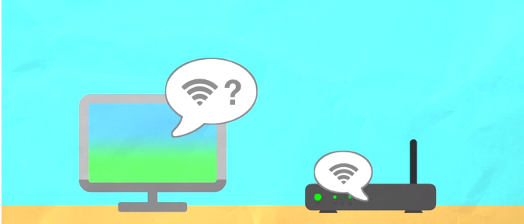
Handshake

Slide 8


Handshake

Slide 9
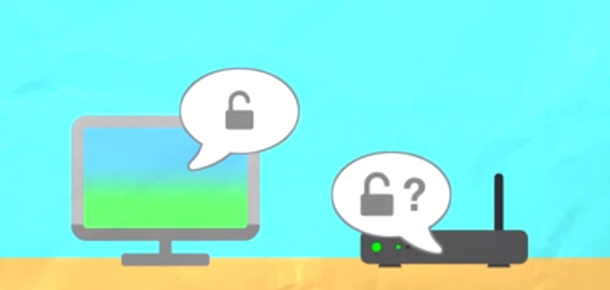


Handshake

Slide 10
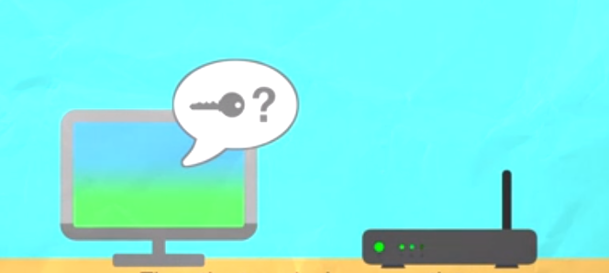



Handshake

Slide 11





Handshake

Slide 12





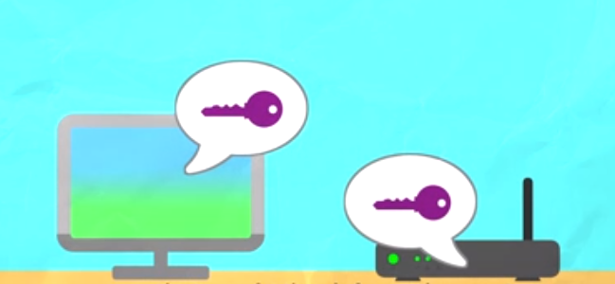
Handshake

Slide 13






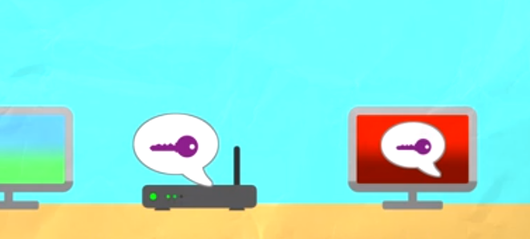
Handshake

Slide 14

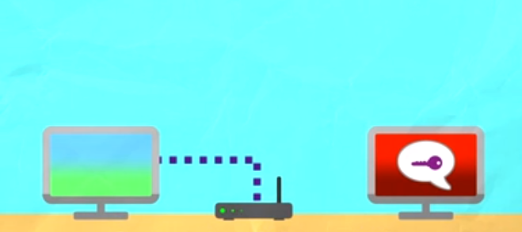
Handshake

Slide 15

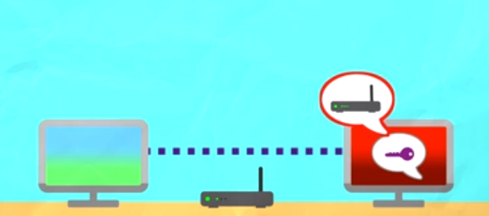
Handshake

Slide 16
Temporal keys WPA2
PTK : Pairwise Transient Key
Protects unicast communications between AP and client
Generated using EAPOL 4-way Handshake
PTK = Function of (PMK,Nonce(Aonce), Nonce(Sonce), MAC Adr)
GTK : Group Transient Key
Protects broadcast/multicast communications from AP to clients
Transported from AP to client in EAPOL 4-way Handshake or Group 2-way Handshake
IGTK : Integrity Group Transient Key
Protects broadcast/multicast management frames (MFP)from AP to clients
Transported from AP to client in EAPOL 4-way Handshake or Group 2-way Handshake
Used for integrity check of broadcast/multicast management frames and is used to compute the MIC for Broadcast/multicast frames.

Slide 17

Key reinstallations in the 4-way handshake

Slide 18


WPA2: 4-way handshake
Used to connect to any protected Wi-Fi network
Mutual authentication
Negotiates fresh PTK: pairwise transient key

Slide 19


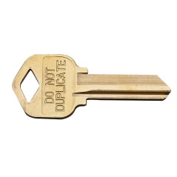


WPA2: Encryption algorithm
Plaintext data
Flags | MAC Adr | Packet Number (PN) | Counters
Packet key
PTK Mix
(session key)
Mix
Nonce
→ Nonce reuse implies keystream reuse (in all WPA2 ciphers)

Slide 20
Peril of packet number reuse
So, if two packets P1 and P2 are encrypted with PTK, then
E1 = P1⊕ KS1 E2 = P2⊕ KS2
and if P1 and P2 were to use same Packet Number (PN), then KS1 = KS2
in that case, E1⊕ E2 = P1⊕ P2 [ Effect of encryption eliminated!! ]
So, if P1 is known/can be guessed, it is possible to Decrypt P2

Slide 21


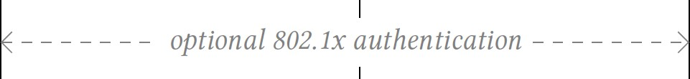
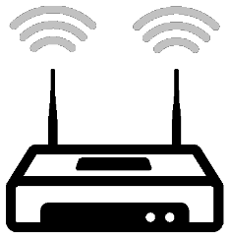
KRACK Attack

Slide 22
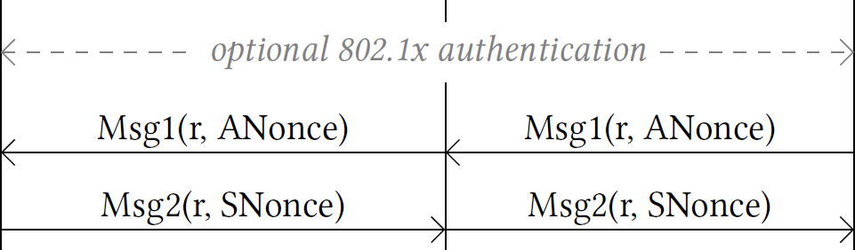
KRACK Attack

Slide 23
KRACK Attack
PTK = Combine(shared secret,
ANonce, SNonce)

Slide 24
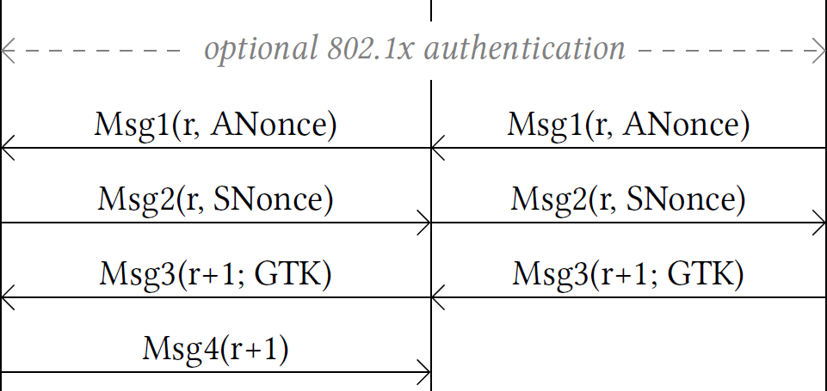
KRACK Attack

Slide 25
KRACK Attack
Block Msg4

Slide 26
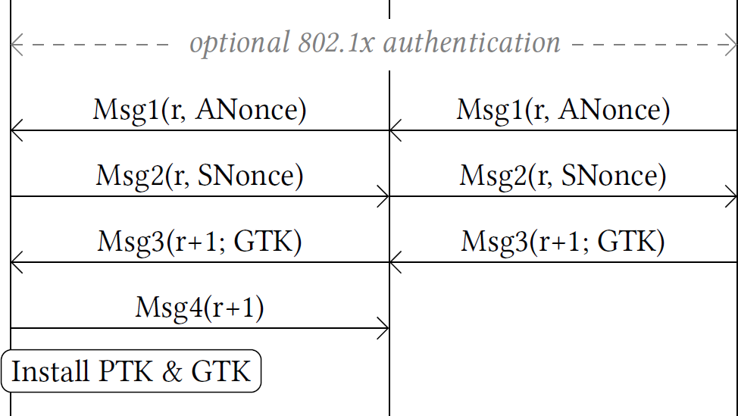
KRACK Attack
Block Msg4

Slide 27
KRACK Attack
PTK is installed & nonce set to zero
Block Msg4

Slide 28
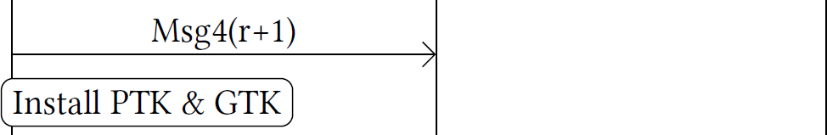
KRACK Attack

Slide 29
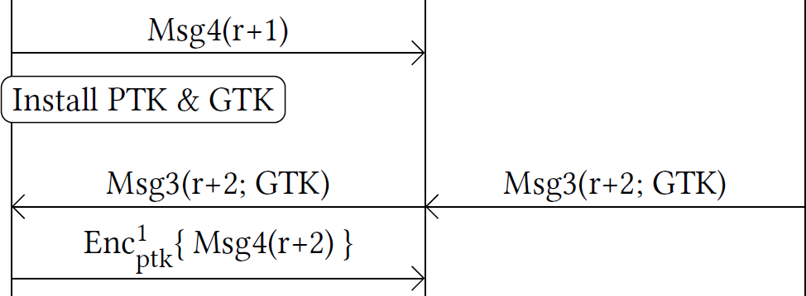
KRACK Attack

Slide 30
KRACK Attack
In practice Msg4 is sent encrypted

Slide 31
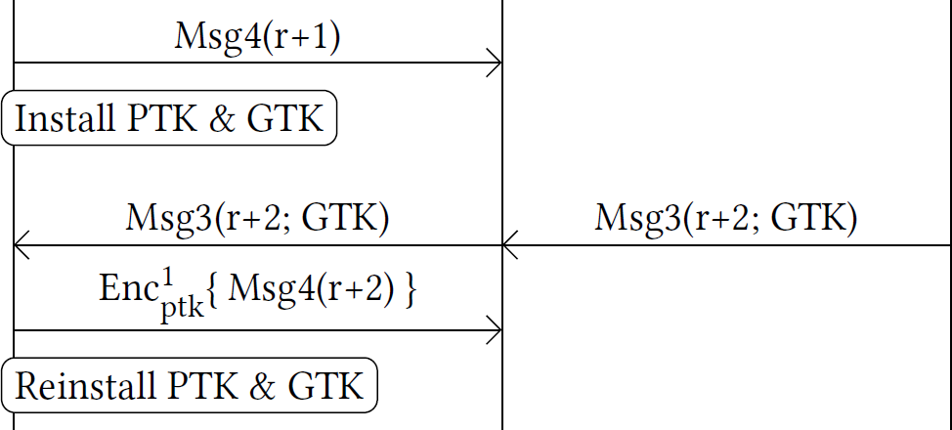
KRACK Attack

Slide 32
KRACK Attack
Key reinstallation: nonce again reset!

Slide 33
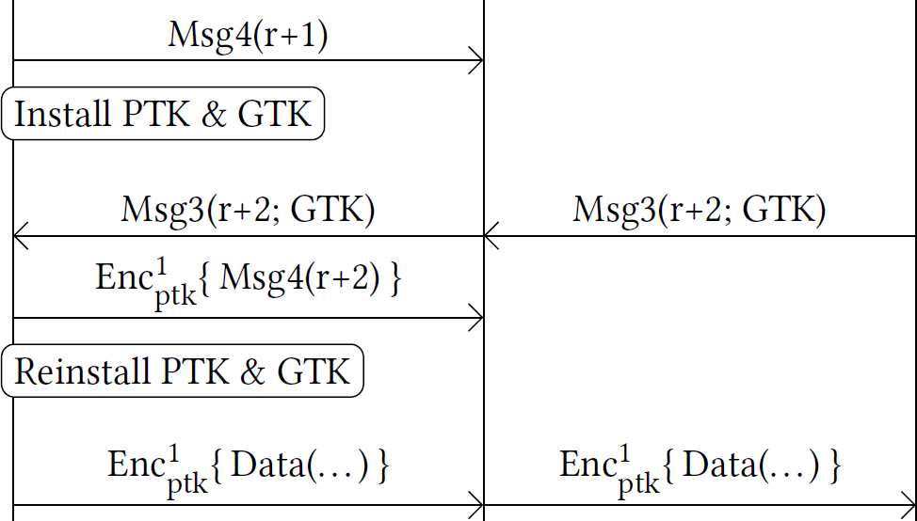
KRACK Attack

Slide 34
KRACK Attack
Next frame reuses previous nonce!

Slide 35
KRACK Attack
Keystream

Slide 36
KRACK Attack
Keystream
Decrypted!

Slide 37

Practical Obstacles

Slide 38
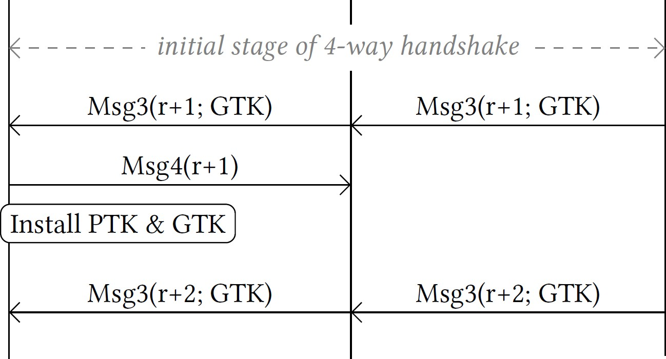
Rejected Msg3

Slide 39
Rejected Msg3
Plaintext Msg3 rejected

Slide 40
Rejected Msg3
Solution: generate encrypted Msg3
Plaintext Msg3 rejected

Slide 41



Slide 42
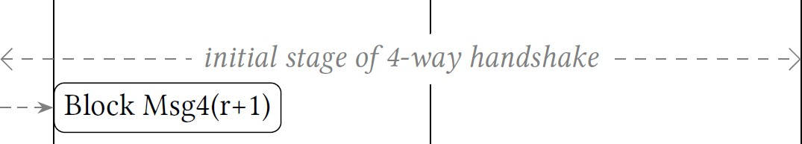

Slide 43
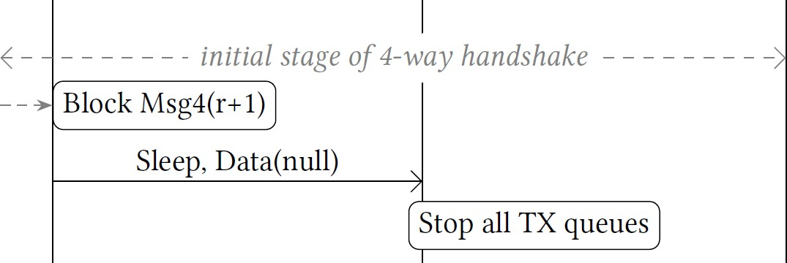

Slide 44
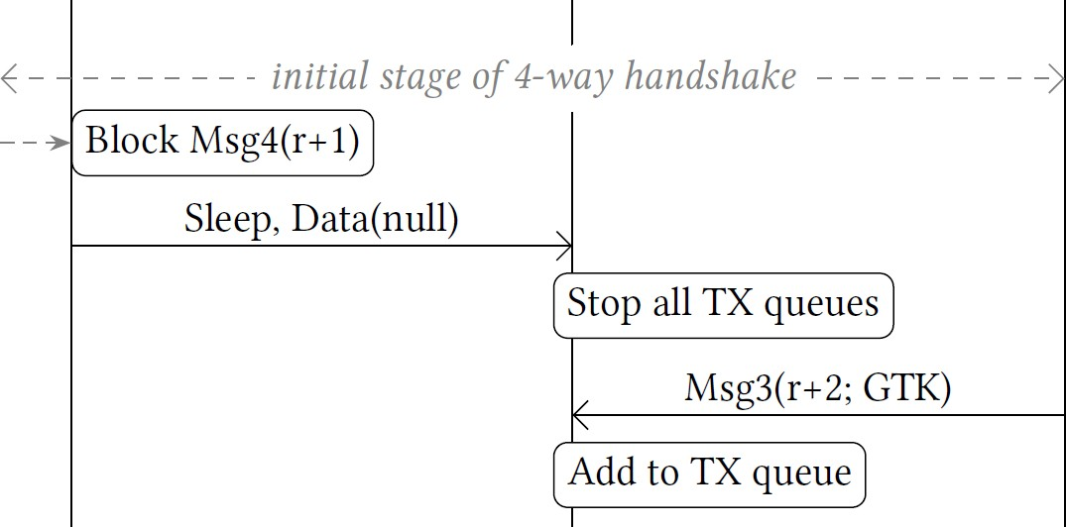

Slide 45
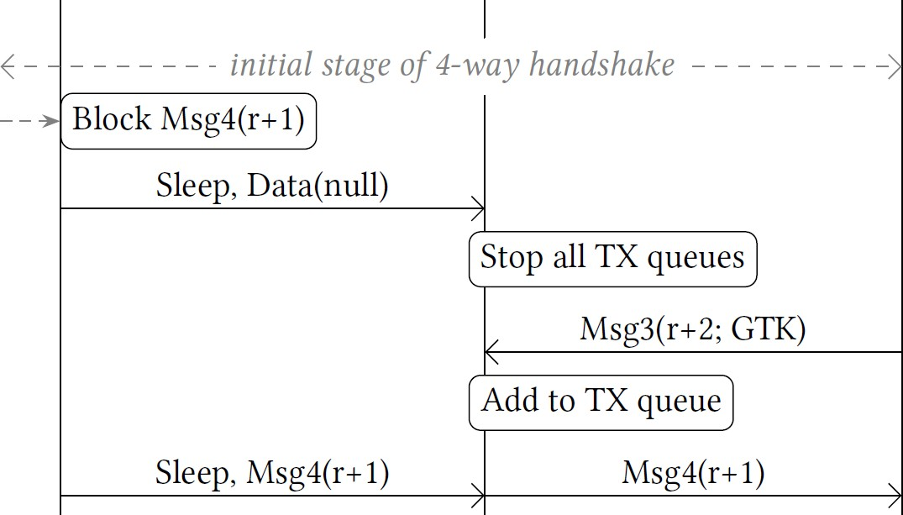

Slide 46

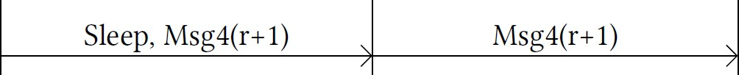

Slide 47
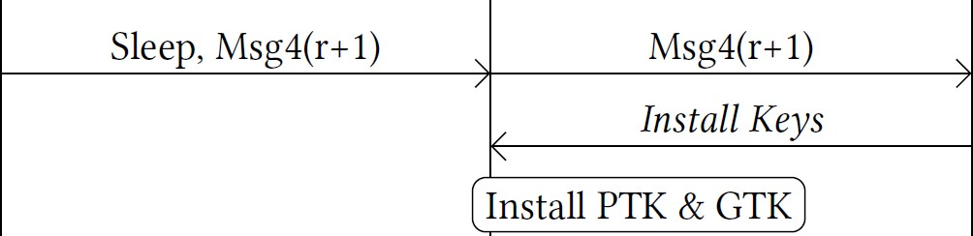

Slide 48
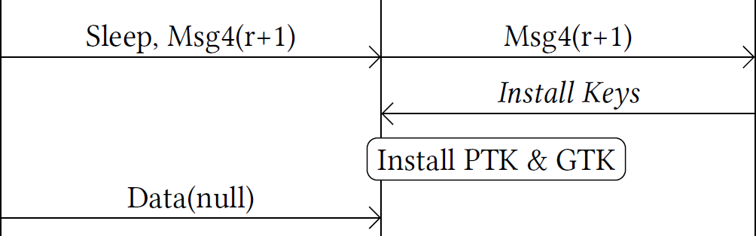

Slide 49
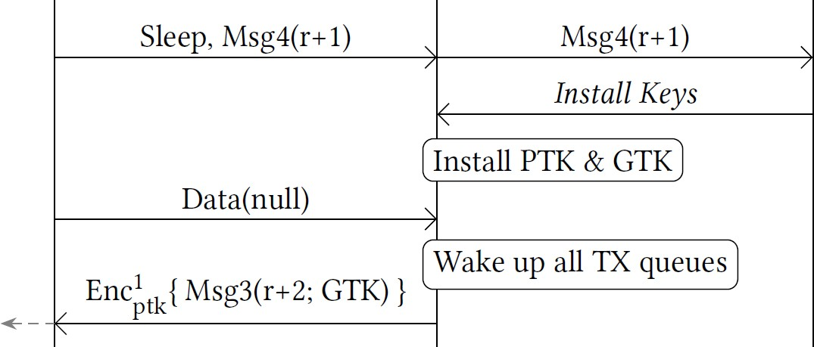

Slide 50
Msg3 is now encrypted

Slide 51
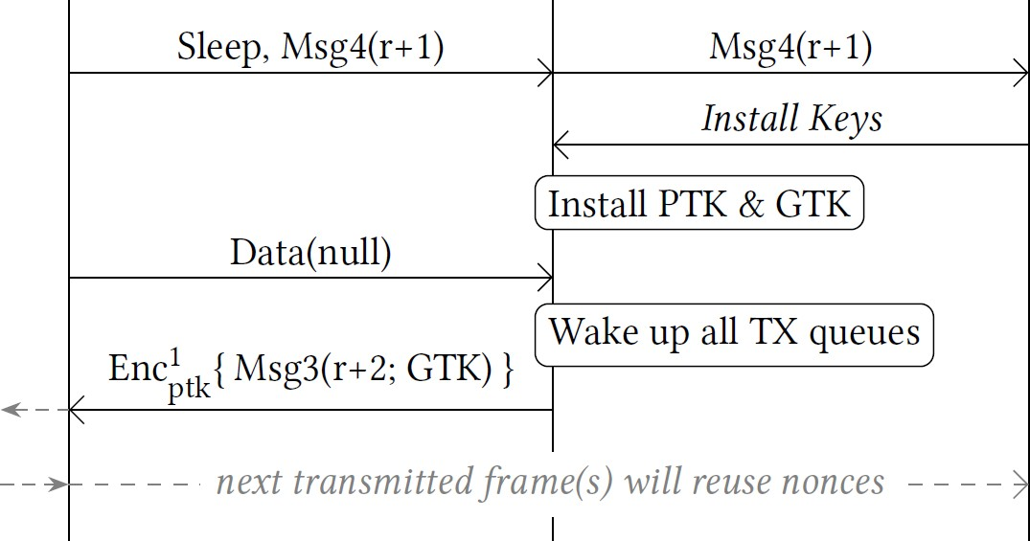

Slide 52

Flawed countermeasure

Slide 53
802.11’s official countermeasure
“When the Key, Address, Key Type, and Key ID parameters identify an existing key, the MAC shall not change the current transmitter TSC/PN/IPN counter or the receiver replay counter values associated with that key.”

Slide 54
Bypassing 802.11’s countermeasure
Group key transported in two frames
› EAPOL-Key frames
› WNM-Sleep frames

Slide 55
Bypassing 802.11’s countermeasure
Group key transported in two frames
› EAPOL-Key frames
› WNM-Sleep frames
We can mix these frames
› WNM-Sleep installs new key
› Then EAPOL-Key reinstall old key

Slide 56
Bypassing 802.11’s countermeasure
Group key transported in two frames
› EAPOL-Key frames
› WNM-Sleep frames
We can mix these frames
› WNM-Sleep installs new key
› Then EAPOL-Key reinstall old key
→ Can reinstall the group key, so Can replay the broadcast and multicast traffics

Slide 57
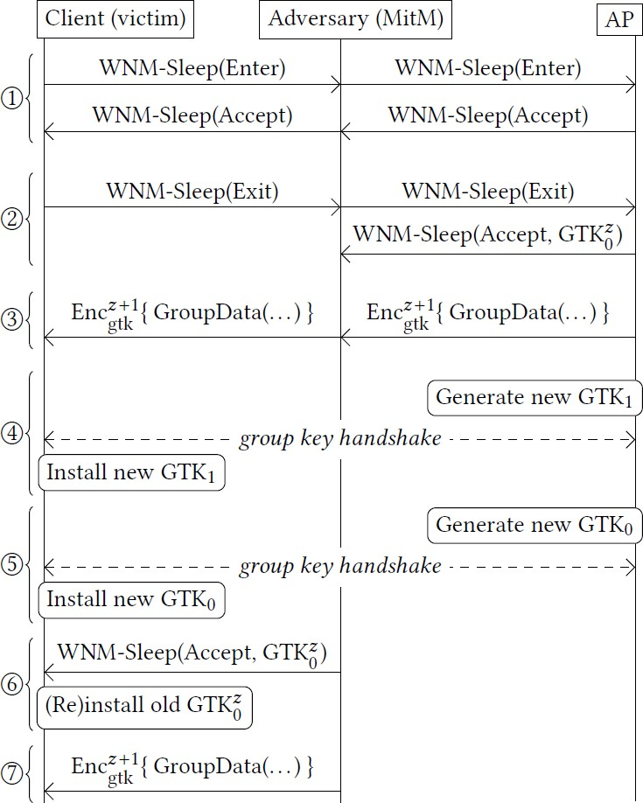
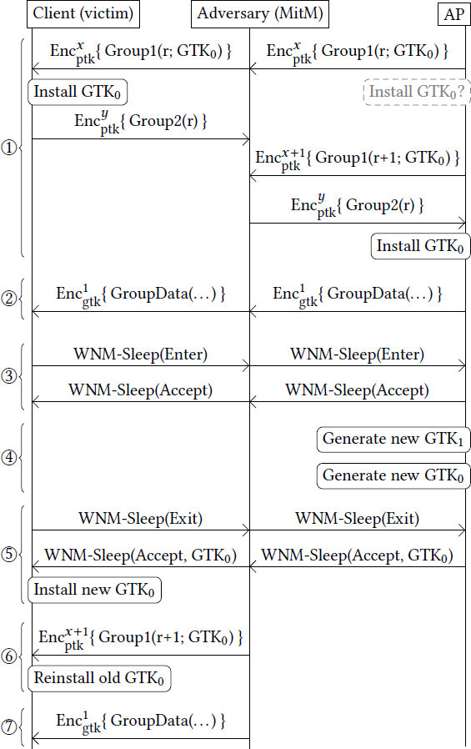
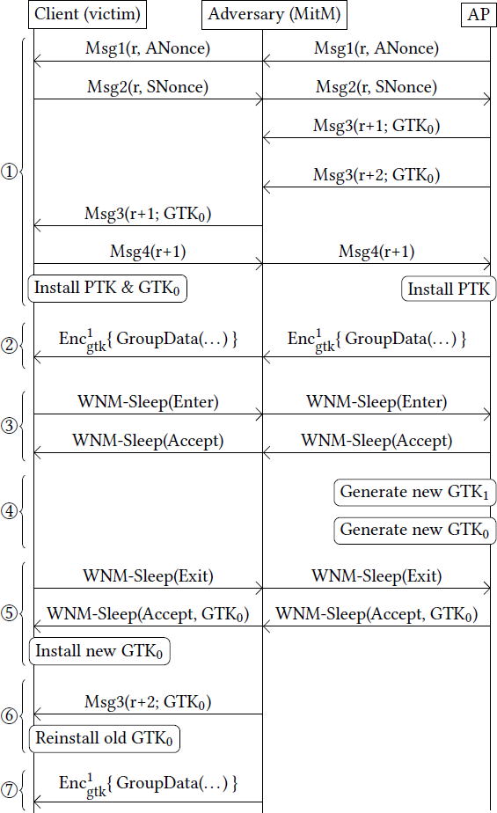
Details are non-trivial
WNM & Group HS group HS & WNM
4-way HS & WNM

Slide 58
Implementation Specific Flaws

Slide 59
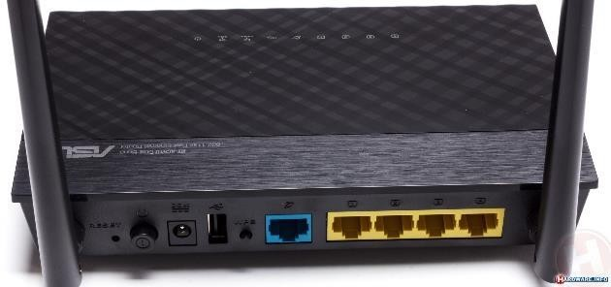
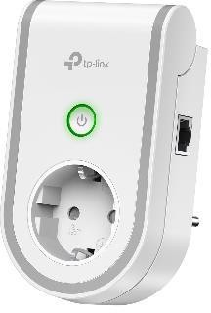
Can we replay Message 4?
› Yes, certain MediaTek Drivers accept replayed Msg4’s
› Used in 100+ devices → many vulnerable products
ASUS RT-AC51U
TP-Link RE370K

Slide 60
Are PTK rekeys implemented properly?
Rekey is a new 4-way handshake
› Same messages exchanged as in initial 4-way handshake
› But new ANonce and SNonce is used
macOS:
› Patched default KRACK attack
› But reused the SNonce during a rekey
› SNonce reuse patched in macOS 10.13.3

Slide 61
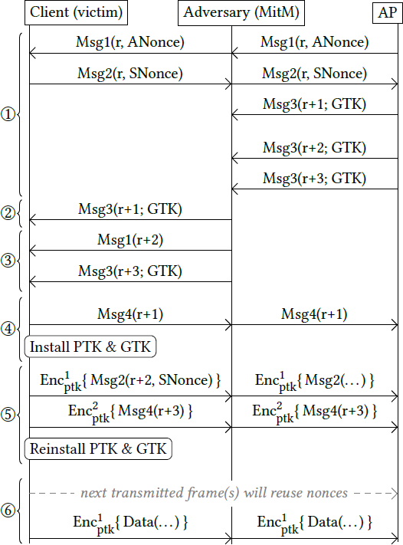
Exploiting macOS’s SNonce reuse
Adversary can replay old handshake
› Need to inject encrypted message 1
› Feasible under specific conditions
› Causes key reinstallation

Slide 62
Other findings
› Vulnerability of First Initial Link Setup (FILS) and Tunneled direct-link setup PeerKey (TPK) handshakes to key reinstallation.
› Mac-serviced Data Unit (MSDU) frames can be abused to spoof the sender and destination frames.
› use of Quality of Service (QoS) by 802.11 can be abused to get improved MitM and Delaying Reinstalls.

Slide 63
Conclusion
› They made attacks more practical
› Bypassed official countermeasure
› showed Handling group keys is hard
› suggested to Keep auditing devices & protocols!

Slide 64
Thank you!
Questions?
krackattacks.com/followup.html

